Slide 1

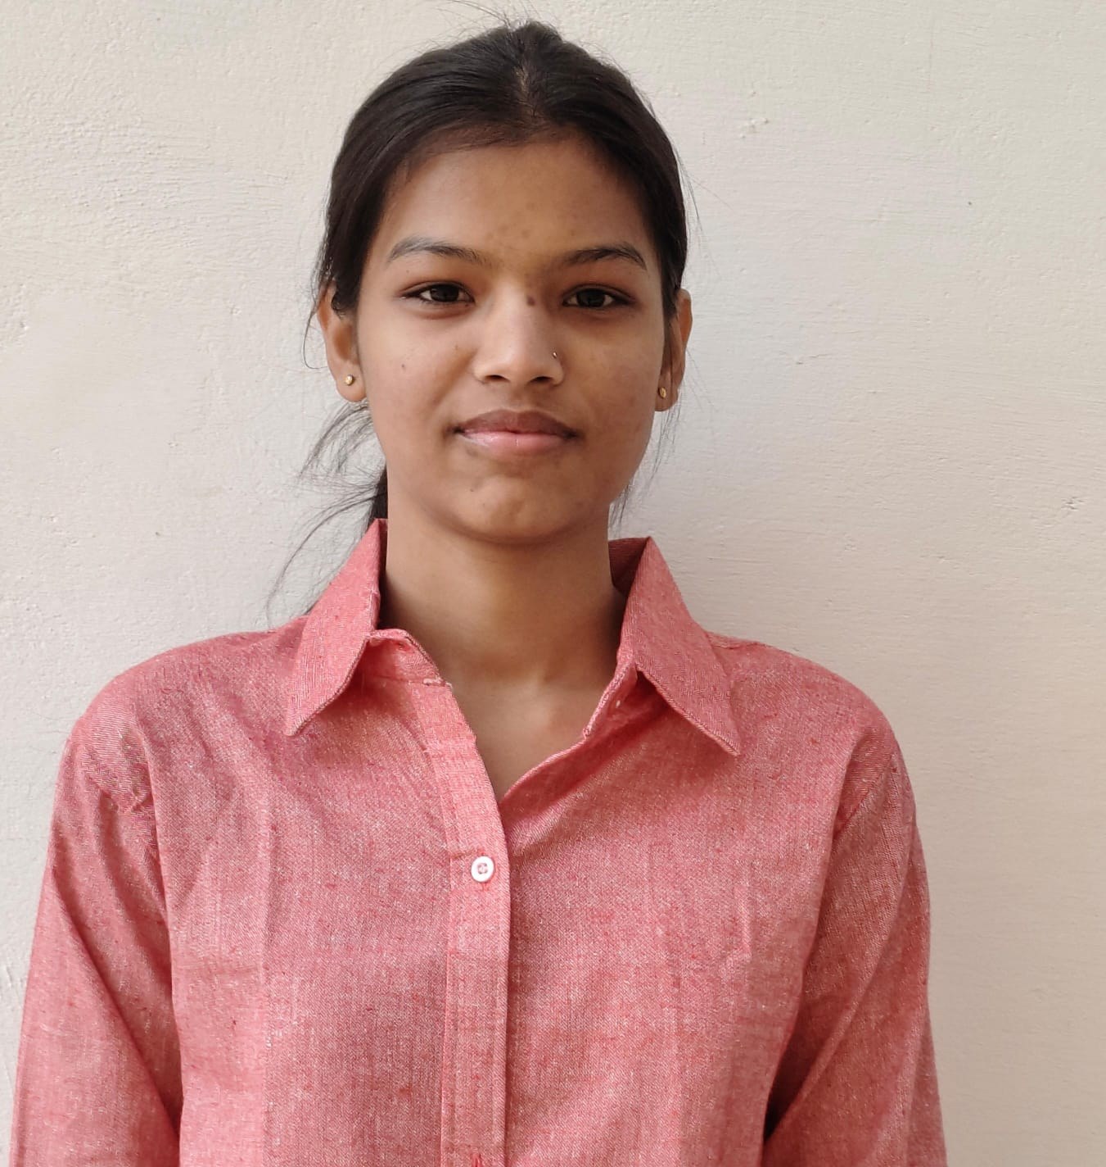
CAPSTONE PROJECT
Fashion Boutique Sales & Product Performance Dashboard
Presented By
Student Name: Anushka yadav
College Name: MAKHANLAL CHATURVEDI NATIONAL UNIVERSITY OF JOURNALISM AND COMMUNICATION
Department: COMPUTER APPLICATION
Email ID: anushkayadavpvt@gmail.com

Slide 2
OUTLINE:
Problem Statement
Proposed System/Solution
System Development Approach
Algorithm & Deployment
Result (Output Image)
Conclusion
Future Scope
References

Slide 3
Problem Statement:
Fashion retailers manage large volumes of product and sales across different categories, brands, and seasons. Analyzing this data manually makes it difficult to understand customer preferences and product performance.
Business need a data-driven approach to identify top-selling products, track revenue trends, and analyze product returns to improve decision-making .

Slide 4
Proposed Solution:
The proposed solution is to build a sales analytics dashboard using Microsoft Power BI to analyze product performance in a fashion boutique.
The dashboard will provide insights including:
• Revenue generated by product category and brand • Seasonal sales trends • Customer ratings and product returns • Overall store performance metrics
This system helps businesses understand customer preferences and improve inventory planning.

Slide 5
System Approach:
Tools and Technologies Used:
• Data Visualization Tool: Microsoft Power BI • Data Source: Retail Sales Dataset • Data Processing: Power Query Editor • Data Modelling: DAX (Data Analysis Expressions) • Visualization Techniques: Charts, KPI Cards, Slicers, and Interactive Dashboards
Steps followed in the development:
Data Collection
Data Cleaning and Transformation
Data Modelling
Dashboard Development
Data Visualization and Insights Generation

Slide 6
Algorithm & Deployment:
Algorithm Selection
Microsoft Power BI was chosen for retail sales analysis, using DAX to calculate metrics like revenue, products sold, customer ratings, and return rate. It was selected for its strong visualization and interactive features.
Data Input
Inputs included sales transactions, product details, customer ratings, and return records.
Training Process
Data was cleaned and transformed with Power Query, ensuring accuracy and consistency before analysis.
Prediction/Analysis Process
A dashboard built in Power BI Desktop provides interactive filters and slicers to explore product performance, seasonal trends, and returns.

Slide 7
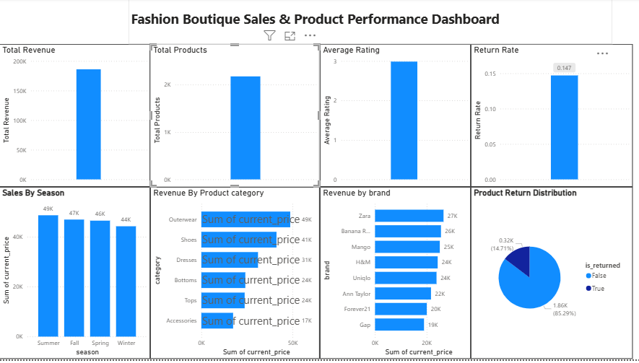
Result:
The developed dashboard provides a clear visualization of fashion boutique sales data. It enables users to analyze product categories, brands, seasonal trends, and product return patterns.
Key insights obtained include:
• Identification of top-performing product categories • Analysis of sales by brand and season • Understanding product return distribution • Evaluation of customer ratings and satisfaction
The dashboard allows users to interact with the data using filters and visual charts.

Slide 8
Conclusion:
This project demonstrates how business intelligence tools such as Microsoft Power BI can transform raw fashion retail data into meaningful insights.
The dashboard helps businesses understand product performance, seasonal demand patterns, and customer feedback. These insights can support better inventory management and marketing strategies.
Overall, the project highlights the value of data-driven decision-making in the fashion retail industry.

Slide 9
Future scope:
Future improvements for this system may include:
• Integration with real-time sales and inventory systems • Implementation of machine learning models for demand forecasting • Expansion of analysis to include customer demographics and buying behavior • Deployment of the dashboard on Power BI Service for cloud-based access
These enhancements can further improve business intelligence capabilities for fashion retailers.

Slide 10
References:
• Microsoft Power BI Documentation • Kaggle Retail Sales Dataset • Data Visualization and Business Intelligence Resources • Online tutorials and documentation related to Microsoft Power BI
GitHub Link:

Slide 11
Thank You

